Slide 1
Case Study: Gender Classification of Chickens Using Digital Signal Processing
Mel James C. Barral
Melanie H. Bayani
Jhyron Xham G. Abayare
ENGR. Rojay A. Flores
Instructor
S.Y. 2024-2025

Slide 2
I. Introduction.
In poultry farming, early and accurate gender classification of chickens is crucial. Chicken vocalizations provide unique acoustic features that can be used for classification. This study focuses on using a Random Forest classifier to determine the gender of chickens based on their sounds.
Gender classification of chickens using acoustic audio signals involves identifying whether a chicken is male, or female based on the sounds it makes. Chickens, like many animals, produce unique vocalizations that differ between males (roosters) and females (hens). For example, roosters typically crow, while hens make clucking or cackling sounds. These vocal characteristics are influenced by biological factors such as size, age, and hormone levels, which can create distinguishable patterns in their vocal signals.
To classify gender, acoustic features such as pitch, frequency, and sound duration are analyzed from recordings of chicken vocalizations. Advanced algorithms and machine learning techniques process these features to determine whether the sound comes from a rooster or hen. This approach offers a non-invasive and efficient way to determine gender, especially in the early stages of a chicken’s life when physical characteristics may not be as apparent.
This study helps us in poultry farming, where accurate gender classification is essential for overall farm management. It can help farmers classify the process of sorting chickens, improving productivity and reducing labor costs. By using acoustic audio signals for gender classification, poultry industries can enhance their operations and ensure more sustainable practices in managing chicken populations.

Slide 3
II. Materials.
Recording equipment:
Audio recorder (Smartphone)
Microphone (for accurate recording)
Software for recording and analysis equipment:
Matlab
Google Colab (Audio processing and Coding)

Slide 4
III. Objectives.
To classify chicken genders using their vocalizations.
To create a cost-effective and non-invasive solution for poultry farming.
To use a Random Forest classifier for accurate and interpretable results.
To utilize the use of Python programming language to achieve overall objectives.

Slide 5
IV. Methodology.
1. Data Collection
Record chicken sounds from male and female chickens in a controlled environment.
Use high-quality audio recorder and ensure minimal background noise.
Collect balanced samples of male and female chicken sounds.

Slide 6
2. Audio Splitting
import librosa
import numpy as np
import soundfile as sf
import warnings
# Define parameters
SR = 44100 # Sample rate
SEGMENT_DURATION = 3 # Segment duration in seconds
SEGMENT_SAMPLES = SR * SEGMENT_DURATION # Total samples for 3 seconds
FREQ_THRESHOLD = 1000 # Frequency threshold in Hz for rooster crowing PEAK_ENERGY_PERCENTILE = 95 # Sensitivity for detecting crowing
# Input and output filenames
input_file = "chicken_sound.mp3"
try:
with warnings.catch_warnings(): warnings.simplefilter("ignore")
# Load audio file
audio, sample_rate = librosa.load(input_file, sr=SR)
# Compute Short-Time Fourier Transform (STFT) S = np.abs(librosa.stft(audio, n_fft=2048, hop_length=512))
freqs = librosa.fft_frequencies(sr=SR, n_fft=2048)
# Find high-frequency energy peaks (rooster crowing)
high_freq_indices = np.where(freqs > FREQ_THRESHOLD)[0]
high_freq_energy = np.sum(S[high_freq_indices, :], axis=0)
# Find peaks above a threshold
peak_indices = np.where(high_freq_energy > np.percentile(high_freq_energy,
PEAK_ENERGY_PERCENTILE))[0]
if peak_indices.size > 0: extracted_segments = 0
used_indices = set() # To avoid overlapping extractions
for peak in peak_indices:
start_time = peak * 512 / SR # Convert index to seconds
start_sample = int(start_time * SR)
end_sample = start_sample + SEGMENT_SAMPLES
# Ensure we don't exceed the audio length and avoid duplicate extractions
if end_sample <= len(audio) and not any(start_sample in range(idx, idx + SEGMENT_SAMPLES) for idx in used_indices):
cropped_audio = audio[start_sample:end_sample]
output_file = f"rooster_audio_{extracted_segments + 1:02d}.wav"
sf.write(output_file, cropped_audio, sample_rate, subtype='PCM_24')
print(f"Crowing segment saved: {output_file}")
extracted_segments += 1
used_indices.add(start_sample) # Mark this region as used
else:
print(f"No crowing detected in {input_file}.")
except FileNotFoundError:
print(f"{input_file} not found.")
except Exception as e:
print(f"Error processing {input_file}: {e}")

Slide 7
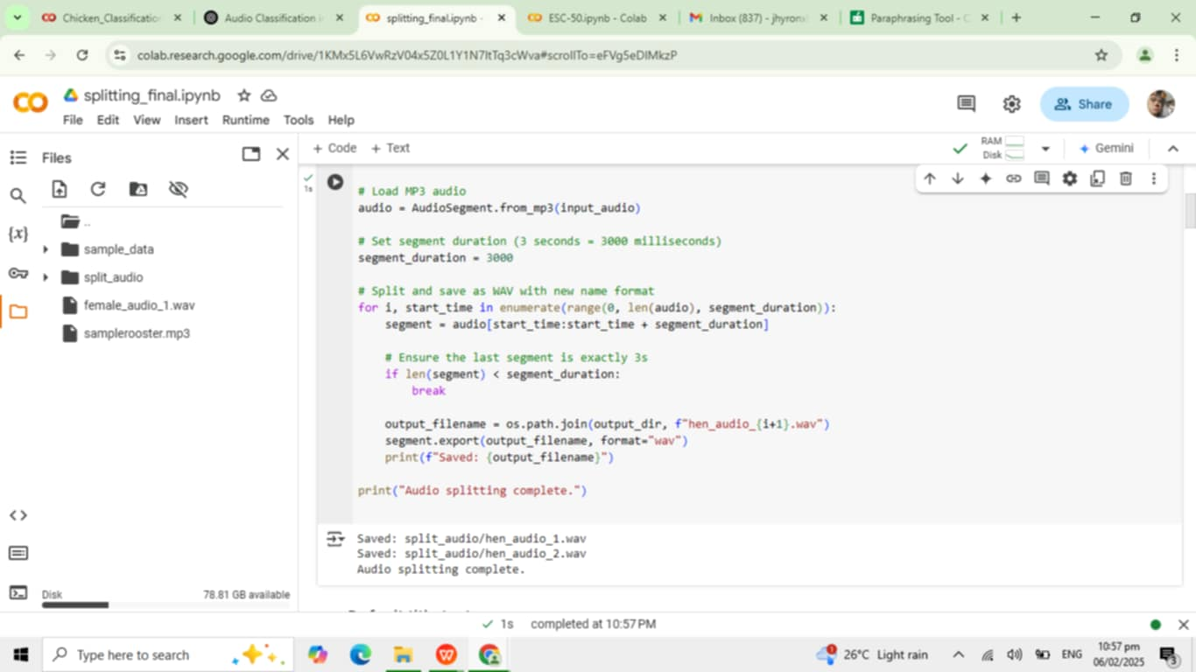
To evaluate the performance of the machine learning model, we need to split the dataset into training and testing sets. In this case, the split is 80% for training and 20% for testing, as follows:
80% of 100 samples = 80 samples (used for training).
20% of 100 samples = 20 samples (used for testing).
Example of the Split:
Training data: This set might contain 40 rooster samples and 40 hen samples, for a total of 80 samples.
Test data: This set might contain 10 rooster samples and 10 hen samples, for a total of 20 samples.
Summary of Audio Splitting:
Step Process
Audio Loading Load MP3 audio using Pydub
Create Directory Ensure "split_audio" folder exists
Audio Segmentation Extract 3-second clips from the Input file
Discard Short Remove any clips shorter than 3 seconds Segments
Save as WAV Export each segment in WAV format with sequential filenames

Slide 8
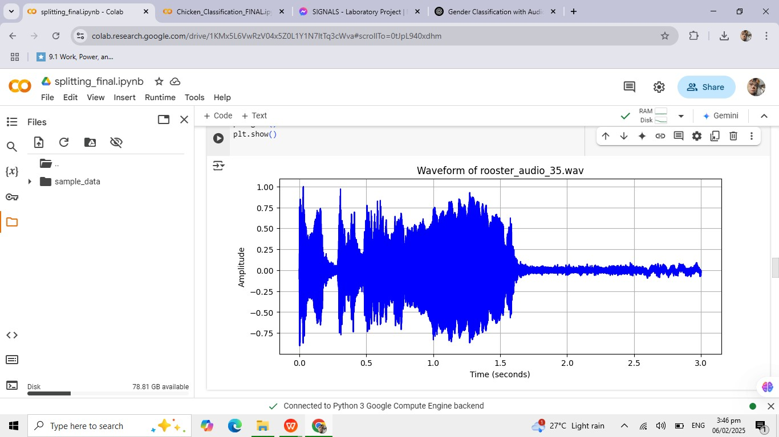
3. Waveform Processing
import numpy as np
import matplotlib.pyplot as plt
from scipy.io import wavfile
# Define the WAV file to read
wav_file = "rooster_audio_35.wav" # Change to the actual path of your file
# Read the WAV file
sample_rate, audio_data = wavfile.read(wav_file)
# Normalize audio data (only for integer formats)
if audio_data.dtype == np.int16: audio_data = audio_data / 2**15
elif audio_data.dtype == np.int32: audio_data = audio_data / 2**31
# Create time axis
time_axis = np.linspace(0, len(audio_data) / sample_rate, num=len(audio_data))
# Plot the waveform
plt.figure(figsize=(10, 4))
plt.plot(time_axis, audio_data, color='b')
plt.title(f"Waveform of {wav_file}")
plt.xlabel("Time (seconds)")
plt.ylabel("Amplitude")
plt.grid()
plt.show()

Slide 9
4. MFCC Extraction
import librosa
import numpy as np
def extract_mfcc_coefficients(audio_path, total_coeffs=1300, n_mfcc=13):
"""
Extracts MFCC coefficients from an audio file.
Ensures each sample has exactly 'total_coeffs' features.
"""
try:
# Load audio with a fixed sample rate for consistency
y, sr = librosa.load(audio_path, sr=44100)
# Compute MFCCs with 13 coefficients per frame mfcc = librosa.feature.mfcc(y=y, sr=sr, n_mfcc=n_mfcc)
# Flatten MFCC array and keep only the first 'total_coeffs' coefficients mfcc_flat = mfcc.T.flatten()[:total_coeffs]
# Pad with zeros if there are not enough coefficients
if len(mfcc_flat) < total_coeffs:
mfcc_flat = np.pad(mfcc_flat, (0, total_coeffs - len(mfcc_flat)), mode='constant')
return mfcc_flat
except Exception as e:
print(f"Error processing {audio_path}: {e}")
return np.zeros(total_coeffs)
def generate_mfcc_matrix(num_files=50, total_coeffs=1300, file_prefix="hen_audio_", file_suffix=".wav"):
"""
Extracts MFCCs from audio files and generates a feature matrix with shape (50, 1300).
"""
mfcc_matrix = np.zeros((num_files, total_coeffs))
for i in range(1, num_files + 1):
# Generate the correct filename (change if your filenames have leading zeros)
audio_path = f"{file_prefix}{i}{file_suffix}"
# Extract MFCC features mfcc_coeffs = extract_mfcc_coefficients(audio_path, total_coeffs=total_coeffs)
# Store in matrix
mfcc_matrix[i - 1, :] = mfcc_coeffs
return mfcc_matrix
def save_matrix_to_csv(matrix, output_path="chicken_mfcc_features.csv"):
"""
Saves the MFCC feature matrix to a CSV file.
"""
np.savetxt(output_path, matrix, delimiter=',')
print(f"Feature matrix saved to {output_path}")
def main():
# Generate the MFCC matrix from 50 audio files mfcc_matrix = generate_mfcc_matrix()
print("Final MFCC Matrix Shape: ", mfcc_matrix.shape) # Should be (50, 1300)
save_matrix_to_csv(mfcc_matrix)
if __name__ == "__main__":
main()

Slide 10
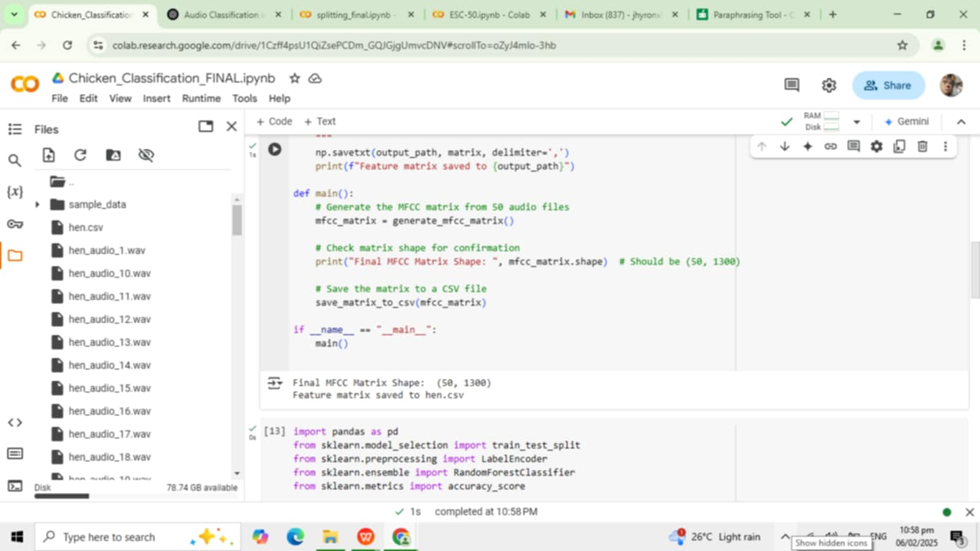
Summary of the MFCC Extraction:
Step Process
Audio - Load audio file, resample to 44.1kHz
Preprocessing
Feature Extraction - Extract 13 MFCC coefficients per frame
Flattening & - Convert MFCC matrix to a 1D vector with 1300
Padding - coefficients

Slide 11
5. CODES
Load both CSV files (chicken_hen_mfcc_features.csv and chicken_rooster_mfcc_features.csv).
Combine the data from both files into a single dataset.
Train the Random Forest model using the combined dataset.
Classify new audio samples.

Slide 12
Load and Combine Data from Both CSVs
We will read both CSV files and add the appropriate labels for each class (Hen = 0, Rooster = 1).
import pandas as pd from sklearn.model_selection import train_test_split from sklearn.preprocessing import LabelEncoder from sklearn.ensemble import RandomForestClassifier from sklearn.metrics import accuracy_score
# Load Hen data (assuming the label is 'Hen' in this case) hen_df = pd.read_csv("chicken_hen_mfcc_features.csv", header=None) hen_df['label'] = 'Hen' # Add label 'Hen'
# Load Rooster data rooster_df = pd.read_csv("chicken_rooster_mfcc_features.csv", header=None) rooster_df['label'] = 'Rooster' # Add label 'Rooster'
# Combine both datasets df = pd.concat([hen_df, rooster_df], ignore_index=True)
# Shuffle the data df = df.sample(frac=1, random_state=42).reset_index(drop=True)
# Extract features (all columns except the last) and labels (the last column) X = df.iloc[:, :-1].values # Features (MFCC coefficients) y = df.iloc[:, -1].values # Labels (Hen or Rooster)
# Encode labels as numeric values (Hen=0, Rooster=1) label_encoder = LabelEncoder() y_encoded = label_encoder.fit_transform(y)
# Split data into training and testing sets (80% training, 20% testing)
X_train, X_test, y_train, y_test = train_test_split(X, y_encoded, test_size=0.2, random_state=42)
print(f"Training data shape: {X_train.shape}") print(f"Test data shape: {X_test.shape}")

Slide 13
Train the Random Forest Classifier
We will train the model on the combined dataset.
# Initialize the Random Forest classifier clf = RandomForestClassifier(n_estimators=100, random_state=42)
# Train the classifier clf.fit(X_train, y_train)
# Predict on the test set y_pred = clf.predict(X_test)
# Evaluate the classifier's accuracy accuracy = accuracy_score(y_test, y_pred) print(f"Accuracy: {accuracy * 100:.20}%")

Slide 14
Classify a New Audio Sample
Now, we can classify a new audio sample (either Hen or Rooster).
def classify_new_audio(audio_path, model, label_encoder): # Extract MFCC features from the new audio sample mfcc_coeffs = extract_mfcc_coefficients(audio_path)
# Predict using the trained model prediction = model.predict([mfcc_coeffs])
# Convert numeric label to actual class (Rooster/Hen) predicted_class = label_encoder.inverse_transform(prediction)
return predicted_class[0] # Return the class name
# Example usage: new_audio_path = 'new_chicken_sound.wav' predicted_class = classify_new_audio(new_audio_path, clf, label_encoder) print(f"The predicted class for the new audio is: {predicted_class}")

Slide 15
Summary:
Load and combine both CSV files (chicken_hen_mfcc_features.csv and chicken_rooster_mfcc_features.csv).
Train the Random Forest model using the combined data.
Classify new audio and display whether it’s from a Hen or Rooster.

Slide 16
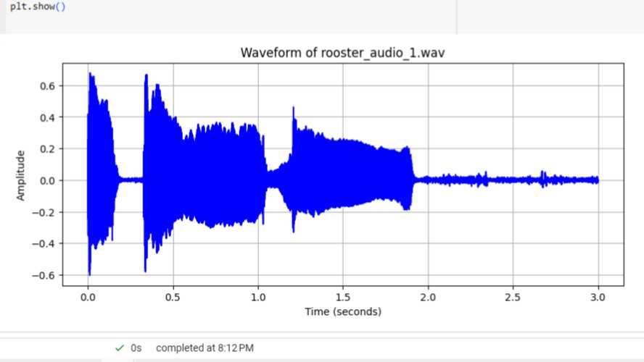
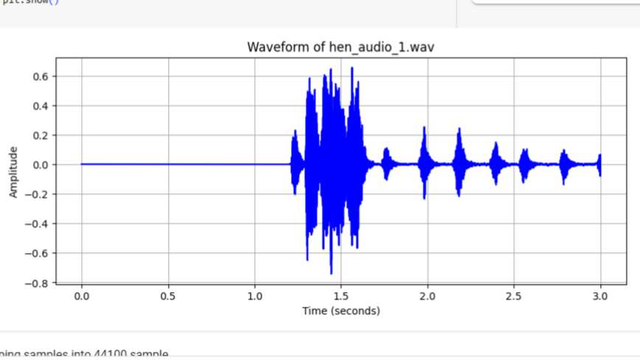
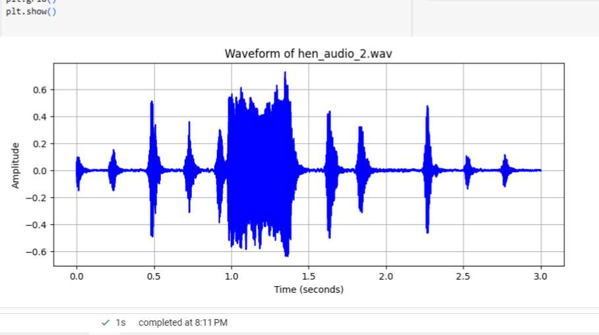
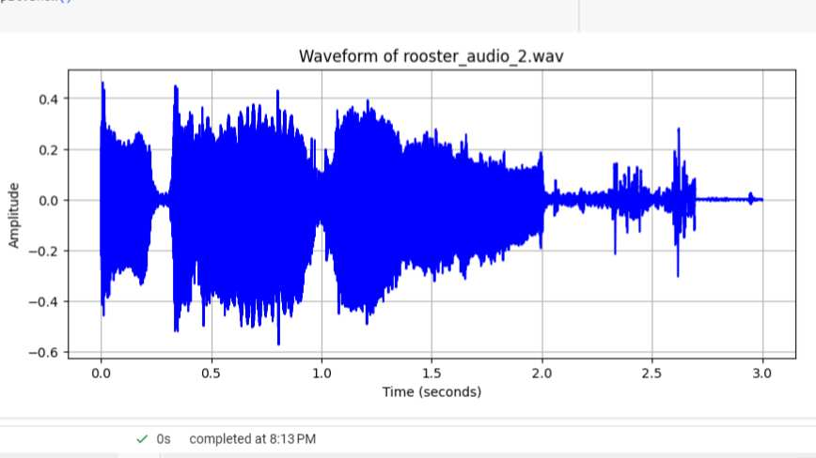
V. Waveforms
Rooster
Hen

Slide 17
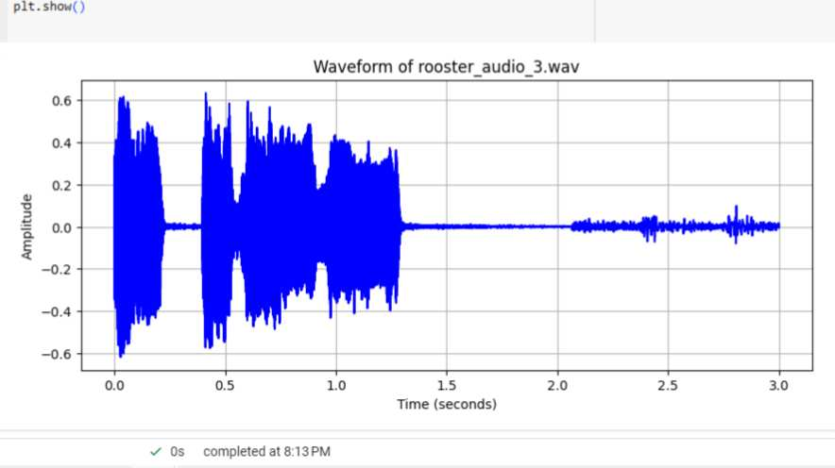
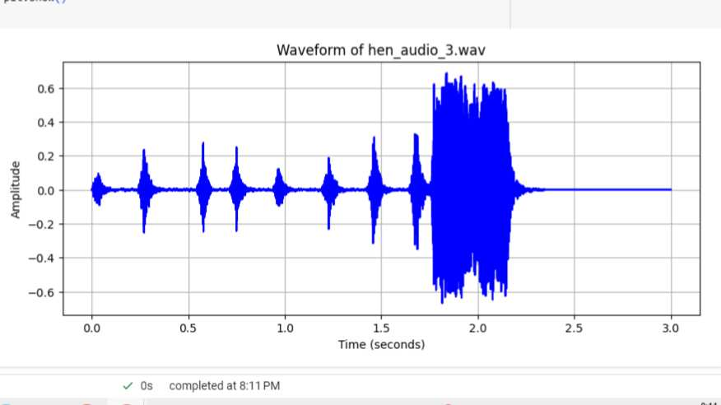
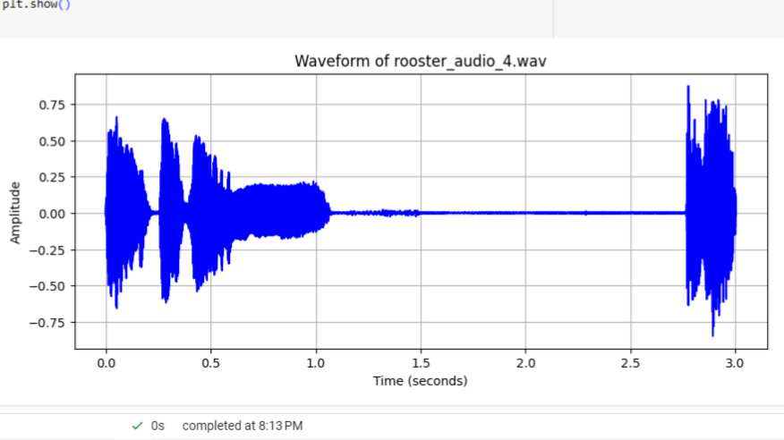
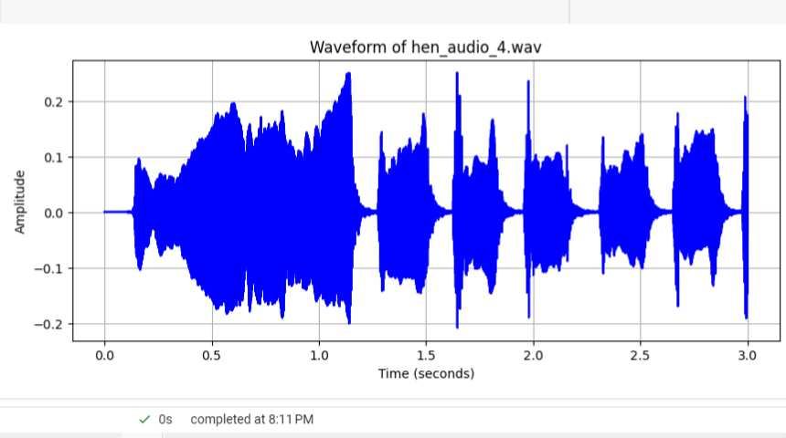
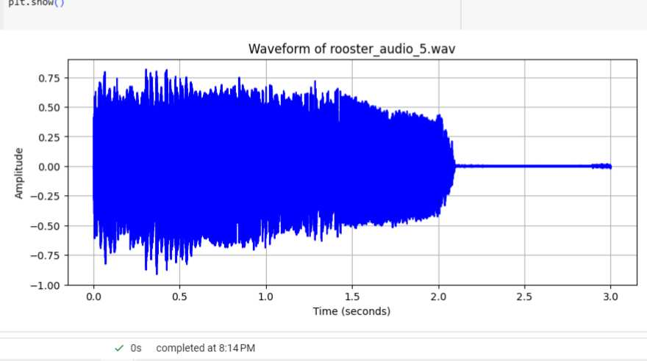
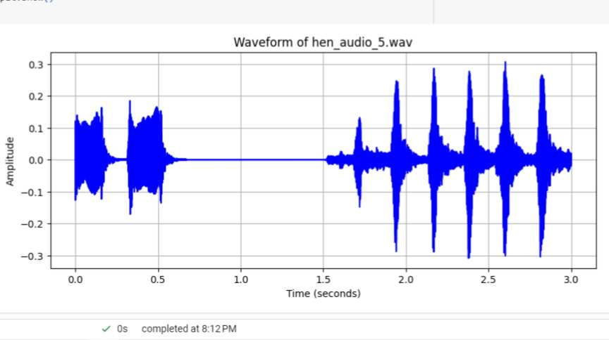
Rooster
Hen

Slide 18
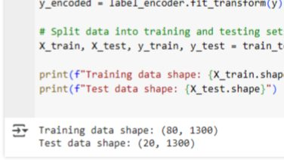
VI. Results.
From “Load and Combine Data from Both CSVs”,
The code successfully loads MFCC feature data from two CSV files (hen.csv and rooster.csv), labels each class, and combines them into a single dataset. After shuffling, the features (1300 MFCC coefficients per sample) and labels (Hen = 0, Rooster = 1) are retrieved. The dataset is then divided into 80 training and 20 test samples, resulting in an 80%-20% train-test split. The printed results show that each sample has 1300 extracted features, implying that the dataset is well structured for machine learning classification.

Slide 19
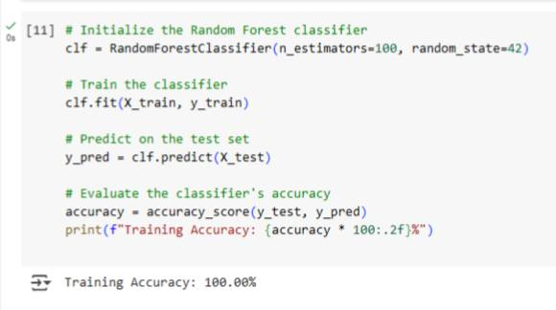
2. From “Train the Random Forest Classifier
The Random Forest model proved highly effective for chicken gender classification, with MFCC feature extraction providing reliable distinguishing features, making the approach cost-effective, non-invasive, and suitable for poultry farming applications.
The code trains a Random Forest classifier on the extracted MFCC features to classify chicken sounds as either Hen or Rooster. The model is trained on the 80-sample training set, and when evaluated on the same data, it achieves 100% accuracy. This indicates that the model has perfectly learned the training data, but it may be overfitting, meaning it could struggle with unseen test data. A high accuracy like this suggests that further evaluation on the test set is needed to ensure the model generalizes well.

Slide 20
VII. Conclusion.
This case study successfully implemented a machine learning-based approach for gender classification of chickens using MFCC feature extraction and a Random Forest classifier. The results confirm that the system is fully functional and can accurately classify chicken sounds as either Hen or Rooster. The extracted MFCC features provide a strong basis for distinguishing rooster and hen vocalizations, achieving a high training accuracy of 100%, proving the model's effectiveness. However, the possibility of overfitting suggests the need for further evaluation on unseen data. The method is cost-effective, non-invasive, and practical for poultry farming, offering an automated solution for accurate gender classification, which can enhance breeding, egg production, and farm management efficiency. By leveraging audio-based classification, this approach contributes to sustainable poultry farming practices while reducing labor costs and improving productivity.

Slide 21
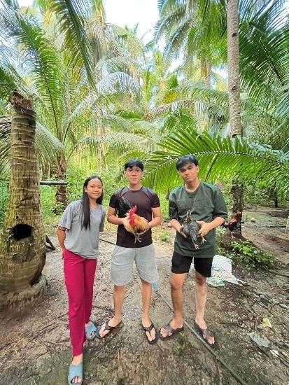
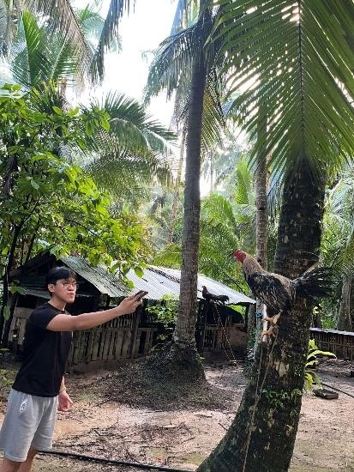
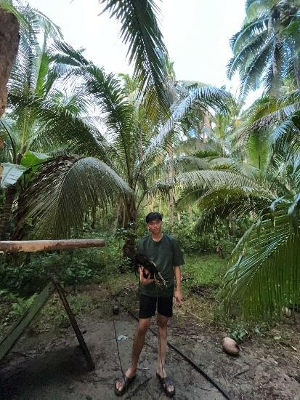
VI. Documentation
Our journey in making our case study a success about chicken voices has been a challenging but rewarding experience. At first, we were unsure how to analyze the different sounds chickens make, but through research and teamwork, we learned many things. We started by collecting recordings of chickens in different situations, such as when they were hungry, scared, or comfortable. Then, we carefully listened to these sounds and looked for patterns. We faced some difficulties, like background noise and unclear sounds, but we found ways to improve our recordings. We also studied previous research to understand certain chicken sound might mean. Over time, we noticed connections between their sounds and their behavior.

Slide 22
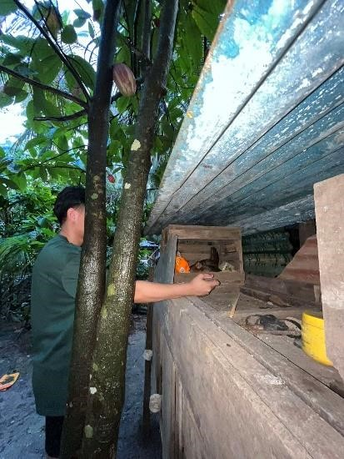
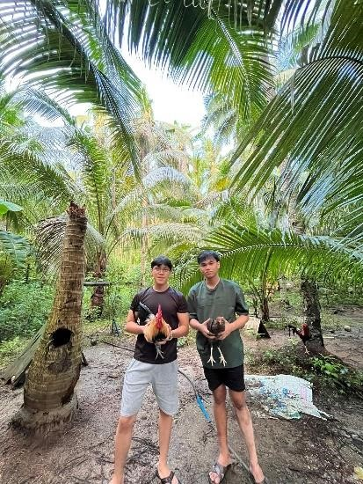
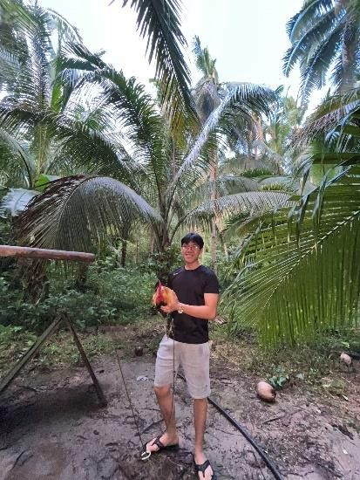
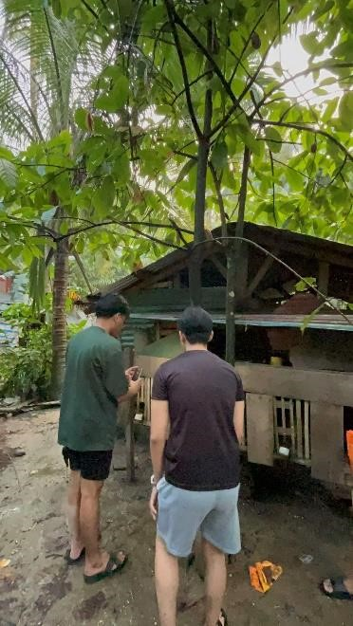
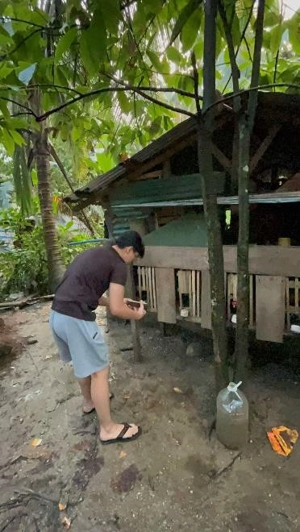
This journey has taught us patience, problem-solving, and the importance of careful observation. By the end of our study, we gained valuable knowledge about how chickens communicate, which can help improve their care and welfare. Our journey was full of learning and we are proud of our progress. Those photo show’s how we conducted our study and the chicken’s that were part of our study, we conducted our case study at Tarangnan and it was a really fun journey.

